Slide 1
Machine Learning
Gradient Descent Algorithm
Linear Regression
Non-Linear Regression
Logistic Regression
Decision Trees
Regression Trees
Classification Trees
Clustering Algorithms
K-Means
Hierarchical clustering
DB-Scan
Mean Shift
GMM
Support Vector Machine
Deep Learning
MLP
CNN
Datasets
Breast Cancer Wisconsin
MIMIC-III
Framingham Heart Study
Alzheimer’s Disease Neuroimaging Initiative
Drug discovery
Microbiome

Slide 2
Model complexity
my humble ML course

Slide 3
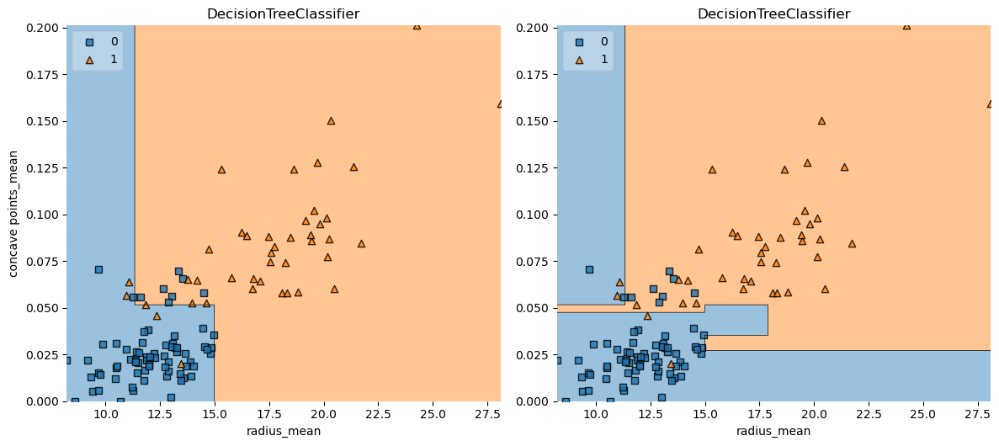
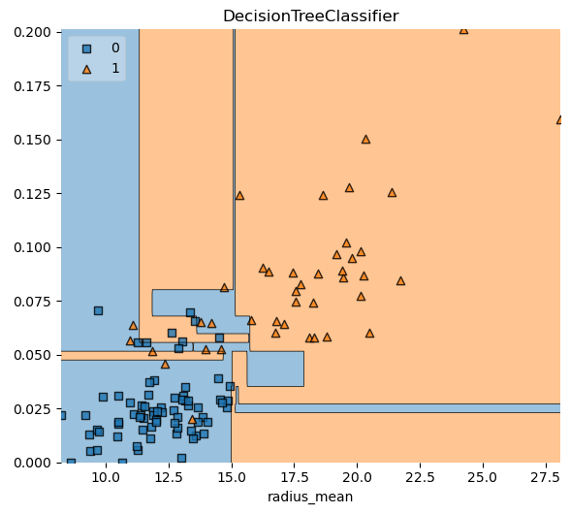
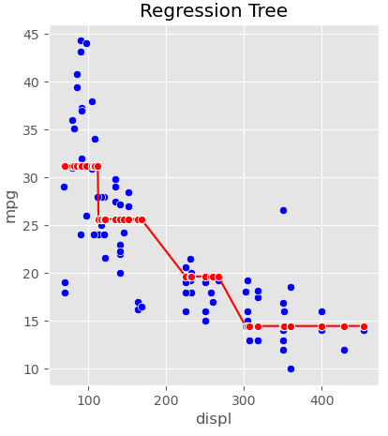
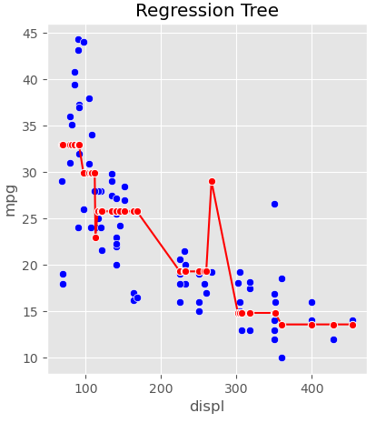
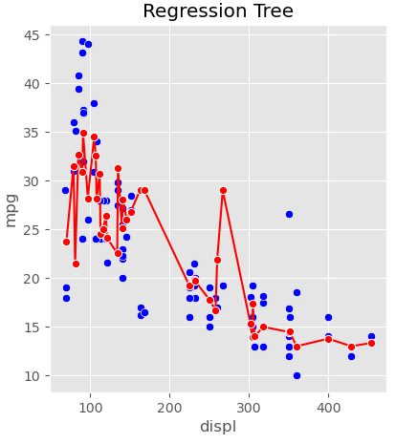
my humble ML course
Notes:
DT
depth = 6 vs 3

Slide 4
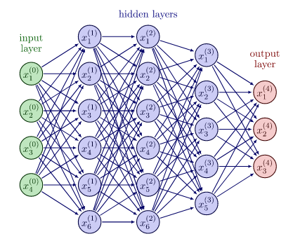
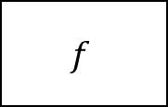
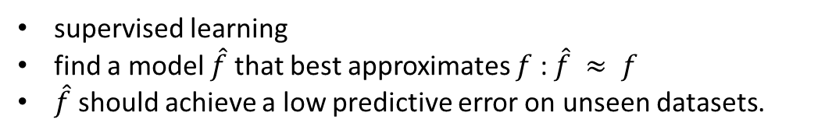

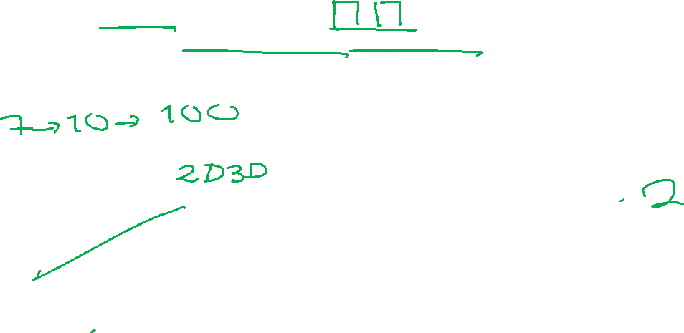


my humble ML course
Model complexity
Input
Output
Real
supervised learning
find a model $\hat{f}$ that best approximates $f$ : $\hat{f} ≈ f$
$\hat{f}$ should achieve a low predictive error on unseen datasets.
$$f$$
$$x$$
$$\hat{y}$$
$$y$$
Model /
Hypothesis
https://www.deep-mind.org/2023/03/26/the-universal-approximation-theorem/
Notes:
Universal Approximation Theorem

Slide 5
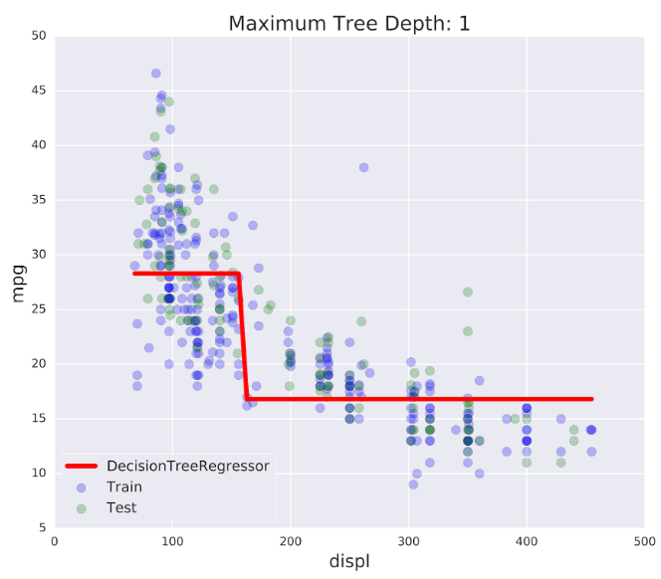
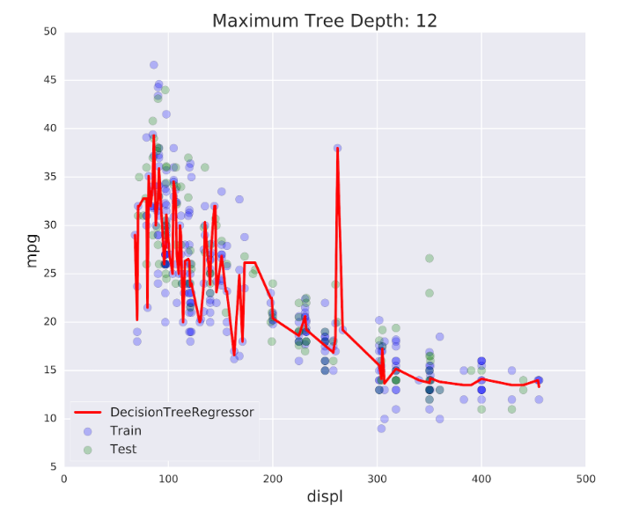
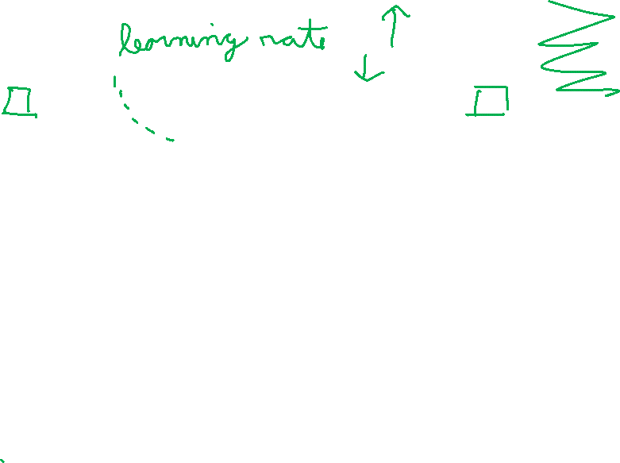


my humble ML course
Model complexity
$\hat{f}$ is not flexible enough to approximate $f$
$\hat{f}$ fits the training set noise
Notes:
underfitting
Overfitting
discard noise as much as possible

Slide 6
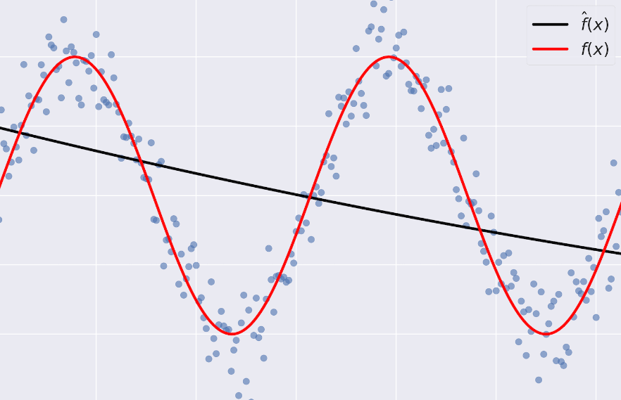
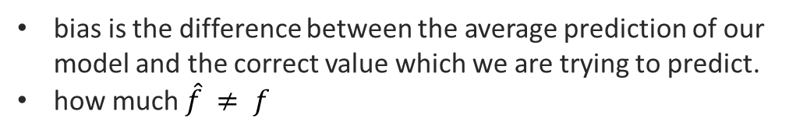
my humble ML course
Bias
bias is the difference between the average prediction of our model and the correct value which we are trying to predict.
how much $\hat{f} ≠ f$
high bias: very little attention to the training data and oversimplifies the model
low bias: …

Slide 7
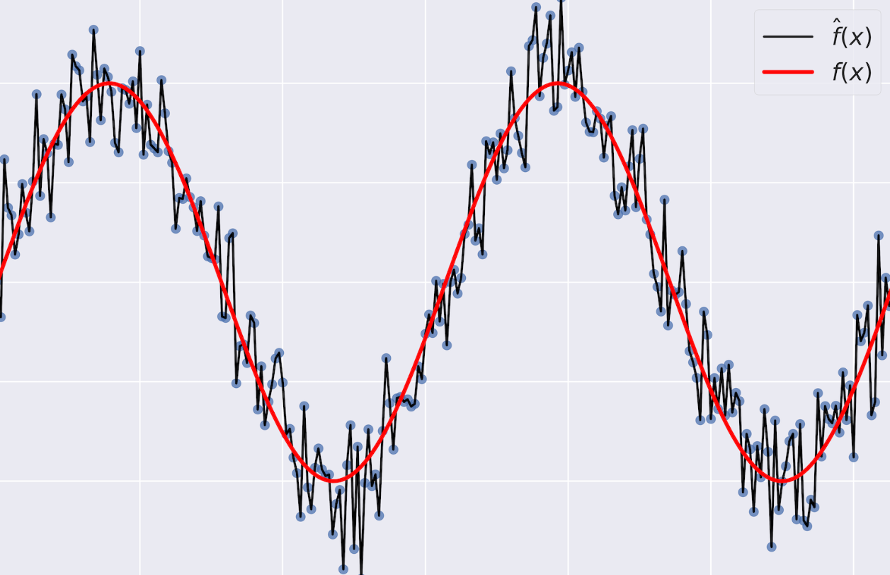
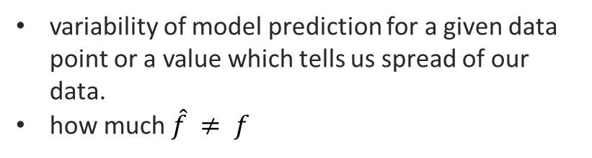
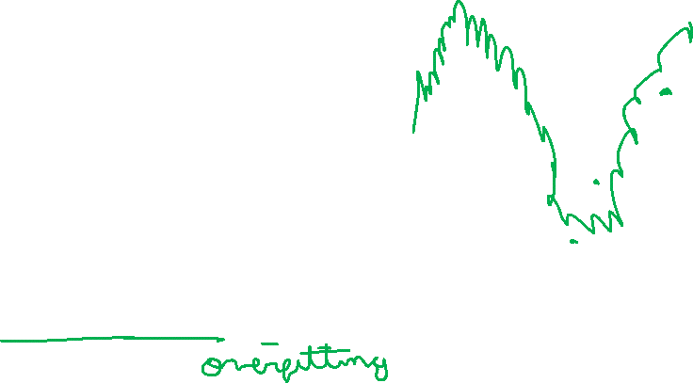
my humble ML course
Variance
variability of model prediction for a given data point or a value which tells us spread of our data.
how much $\hat{f} ≠ f$
high variance: pays a lot of attention to training data and does not generalize on the data which it hasn’t seen before
low variance: …

Slide 8

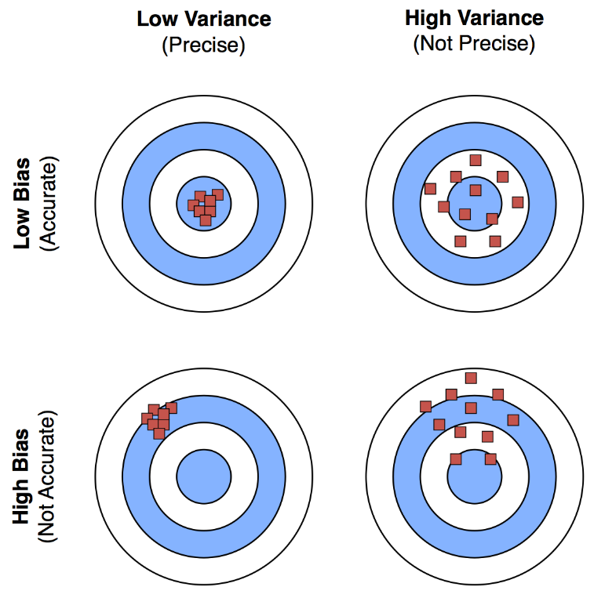
my humble ML course
bias-variance tradeoff
Notes:
Irreducible error is the error that can’t be reduced by creating good models.
It is a measure of the amount of noise in our data.
Here it is important to understand that no matter how good we make our model, our data will have certain amount of noise or irreducible error that can not be removed.
underfitting happens when a model unable to capture the underlying pattern of the data. high bias, low variance
overfitting happens when our model captures the noise along with the underlying pattern in data. low bias and high variance

Slide 9
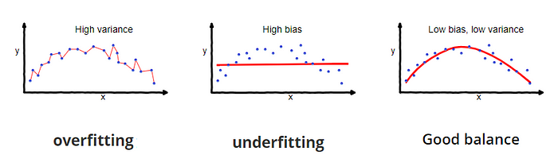
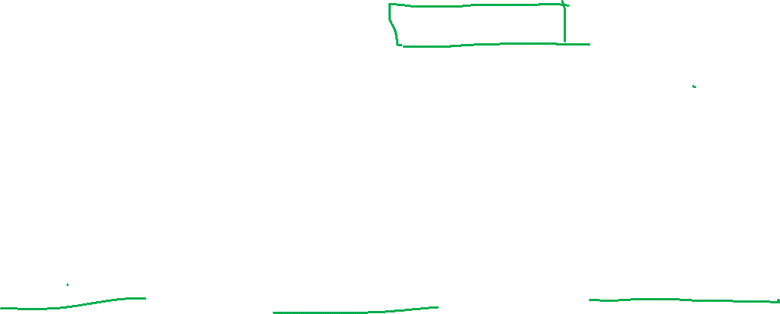
my humble ML course
bias-variance tradeoff
Notes:
Irreducible error is the error that can’t be reduced by creating good models.
It is a measure of the amount of noise in our data.
Here it is important to understand that no matter how good we make our model, our data will have certain amount of noise or irreducible error that can not be removed.
underfitting happens when a model unable to capture the underlying pattern of the data. high bias, low variance
overfitting happens when our model captures the noise along with the underlying pattern in data. low bias and high variance

Slide 10
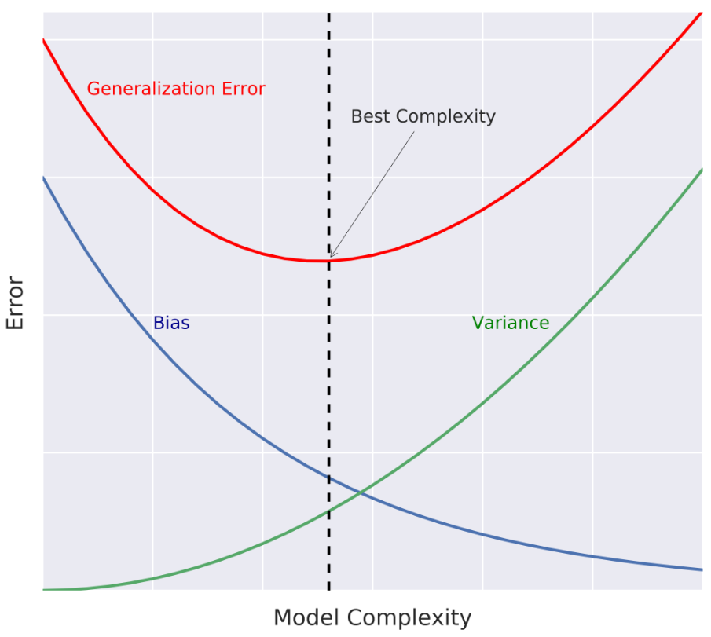
my humble ML course
bias-variance tradeoff
Notes:
Irreducible error is the error that can’t be reduced by creating good models.
It is a measure of the amount of noise in our data.
Here it is important to understand that no matter how good we make our model, our data will have certain amount of noise or irreducible error that can not be removed.
underfitting happens when a model unable to capture the underlying pattern of the data. high bias, low variance
overfitting happens when our model captures the noise along with the underlying pattern in data. low bias and high variance

Slide 11
my humble ML course
bias-variance tradeoff
When the model complexity increases, the variance increases while the bias decreases
When the model complexity decreases, the variance decreases while the bias increases.
Since this error is the sum of three terms with the irreducible error being constant, you need to find a balance between bias and variance because as one increases the other decreases. This is known as the bias-variance trade-off.

Slide 12
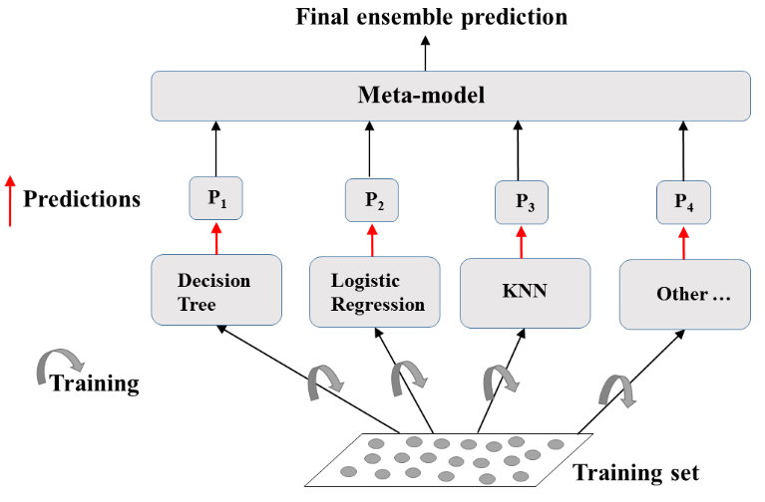
my humble ML course
in context …
CART in practice:
Can easily overfit
How do we regularize?
Can stop if gain is small
But this can be short-sighted
Can use tree pruning
Can use ensemble methods.

Slide 13
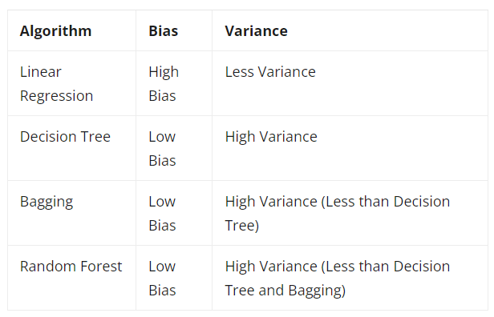
my humble ML course
in context …

Slide 14
Diagnose bias and variance problems
my humble ML course
.

Slide 15
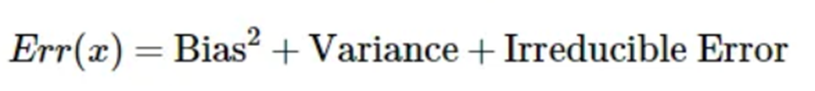
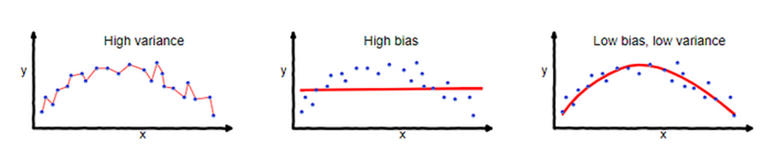
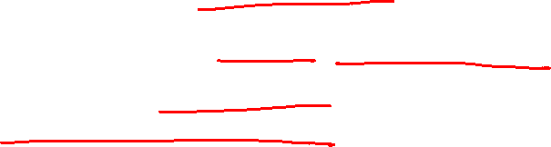
my humble ML course
Generalization error
How do we estimate the generalization error of a model?
ML algorithms -> data-driven models
Usually you only have one dataset
Notes:
tree based models in Google

Slide 16
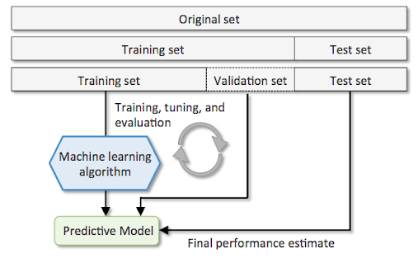
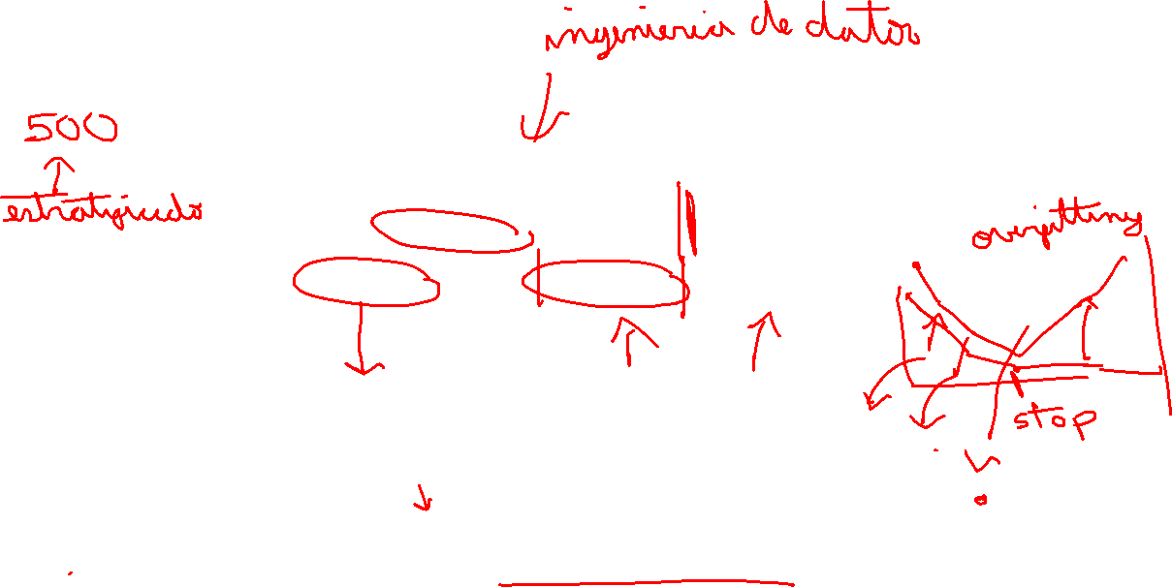
my humble ML course
Hold Out CV
Notes:
tree based models in Google

Slide 17
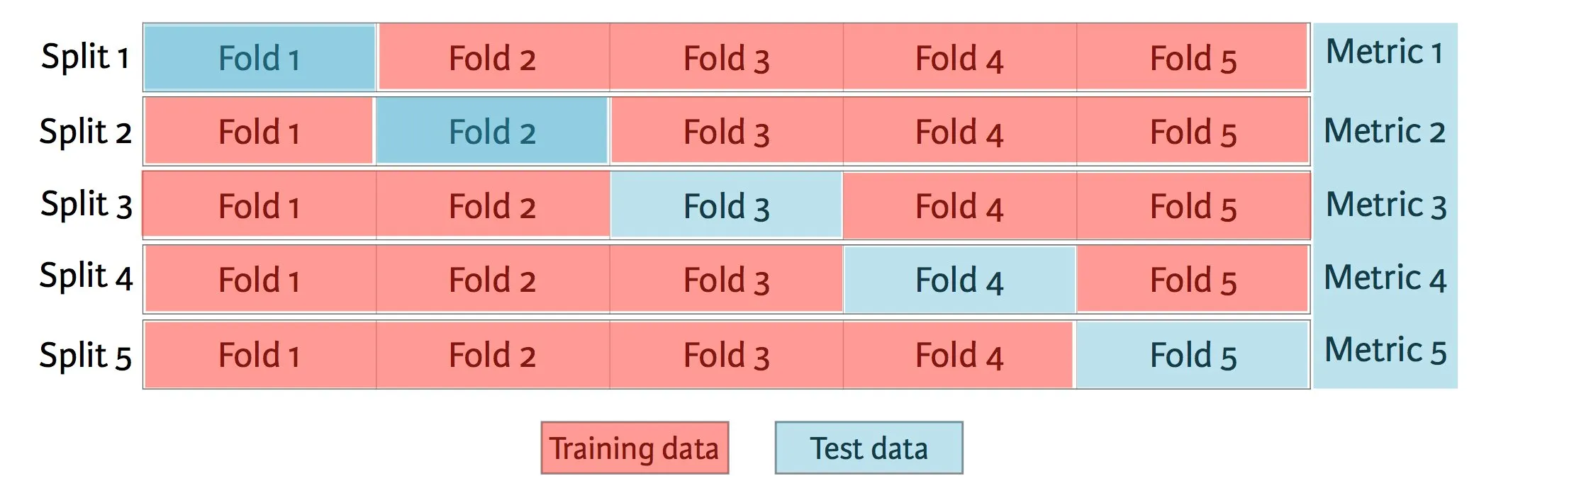
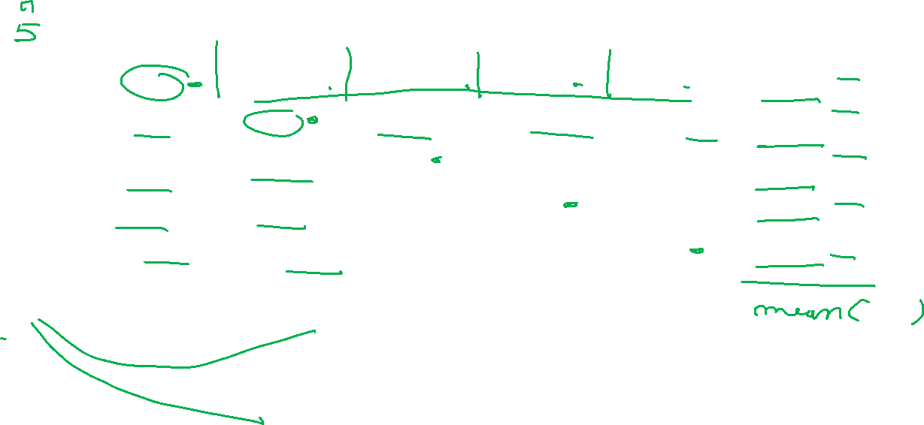
my humble ML course
K Fold CV
Notes:
tree based models in Google

Slide 18
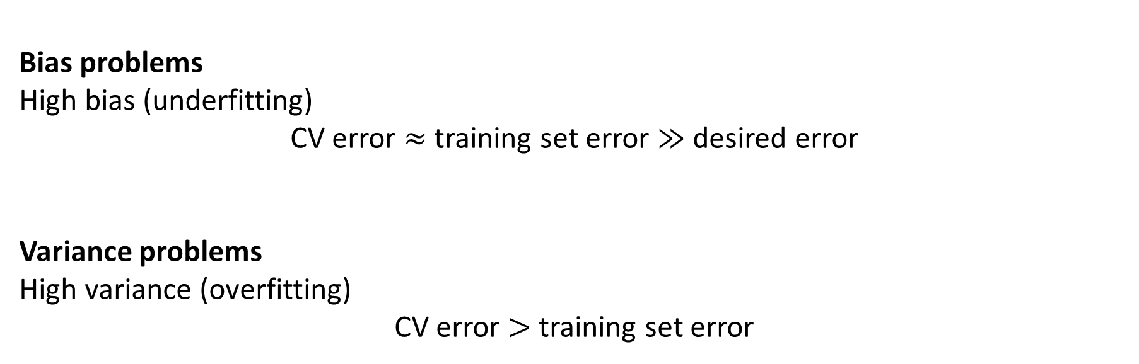
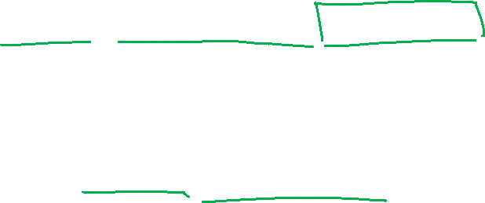
my humble ML course
Diagnose problems
Bias problems
High bias (underfitting)
CV error $≈$ training set error $≫$ desired error
Variance problems
High variance (overfitting)
CV error $>$ training set error
Notes:
tree based models in Google

Slide 19
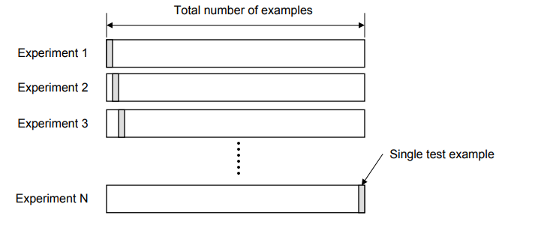
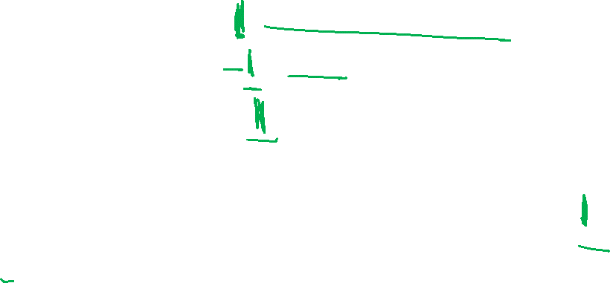
my humble ML course
Leave-One-Out CV (LOOCV)
Notes:
tree based models in Google

Slide 20
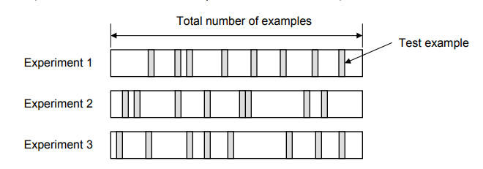
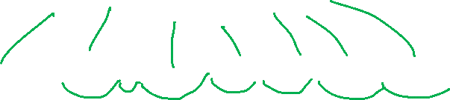
my humble ML course
Random Subsampling
Notes:
tree based models in Google

Slide 21
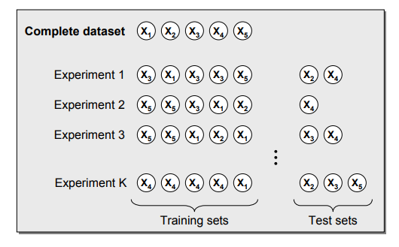
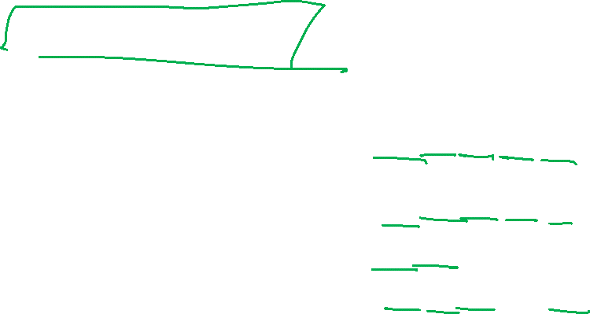
my humble ML course
Bootstrapping
Notes:
tree based models in Google

Slide 22
my humble ML course
Bibliography
https://towardsdatascience.com/understanding-the-bias-variance-tradeoff-165e6942b229
https://app.datacamp.com/learn/courses/machine-learning-with-tree-based-models-in-python
https://www.bmc.com/blogs/bias-variance-machine-learning/
https://medium.com/@eijaz/holdout-vs-cross-validation-in-machine-learning-7637112d3f8f
https://moredvikas.wordpress.com/2018/10/10/machine-learning-model-validation-techniques/
Notes:
https://miro.com/app/board/uXjVMZythnw=/

